Slide 1
Chapter 5 - Linear Models
2016.10.25 장수경
Notes:
http://dogmas.tistory.com/392

Slide 2
목차
Linear Models Introduction
Solving Linear Models
Linear Models as Matrix Multiplication
Interaction effect
실습
Expressing design formula in R
Linear models in practice
Standard errors
Interactions and contrasts
Co-linearity
The QR decomposition

Slide 3
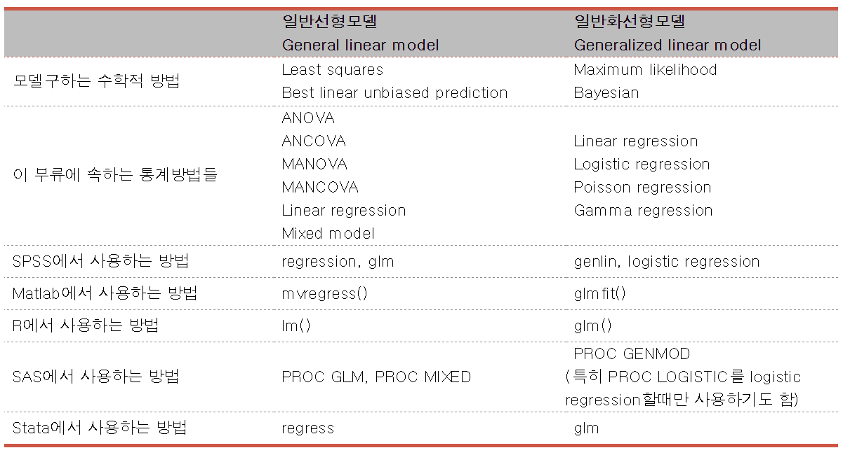
1. Linear Models Introduction
http://dogmas.tistory.com/392

Slide 4
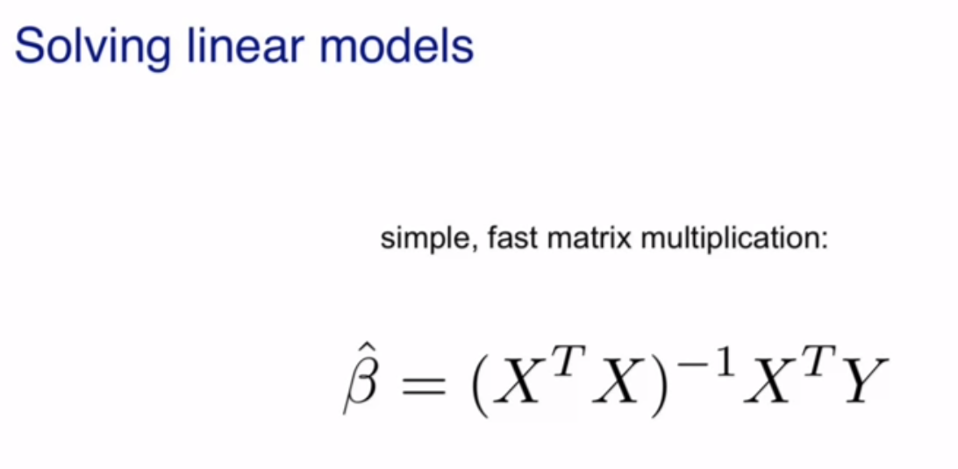
2. Solving Linear Models

Slide 5
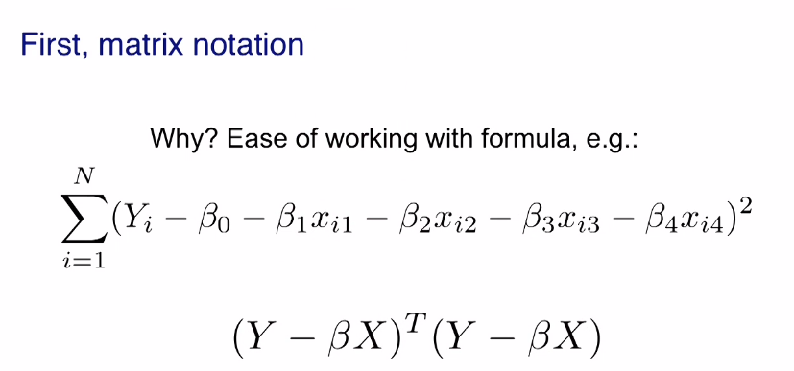
2. Solving Linear Models
- 최소제곱법과 matrix notation
Matrix notation makes writing formulas easy,
it also makes computation easy, it makes mathematics easy.

Slide 6
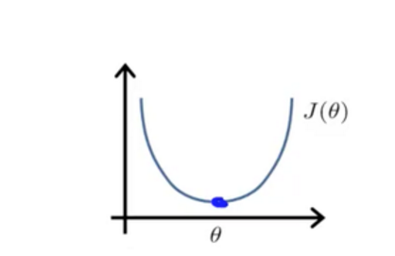
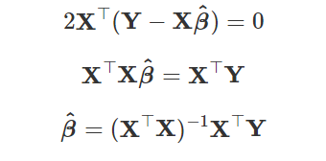
2. Solving Linear Models
- 최소제곱법의 계산(정규방정식,normal equation)
도함수가 0인 지점을 찾는 방식

Slide 7
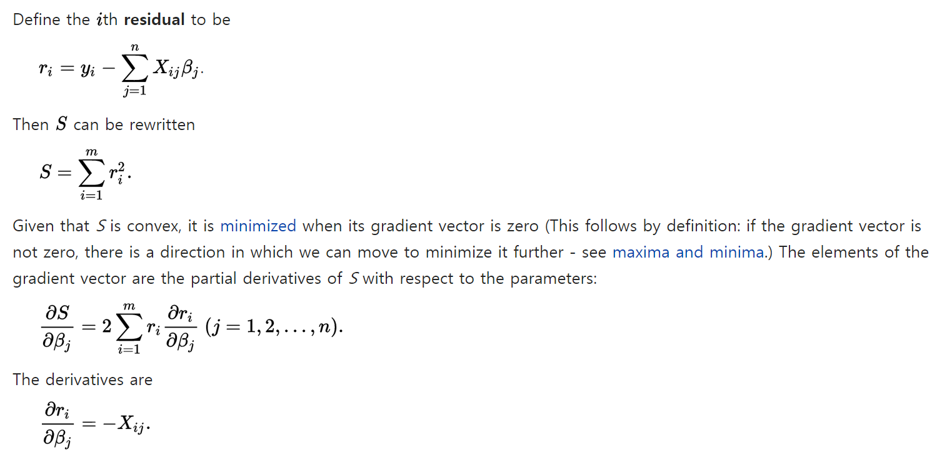
(참고)
최소제곱법의 계산 -분석적(analytic) 방법
https://en.wikipedia.org/wiki/Linear_least_squares_(mathematics)#Derivation_of_the_normal_equations

Slide 8
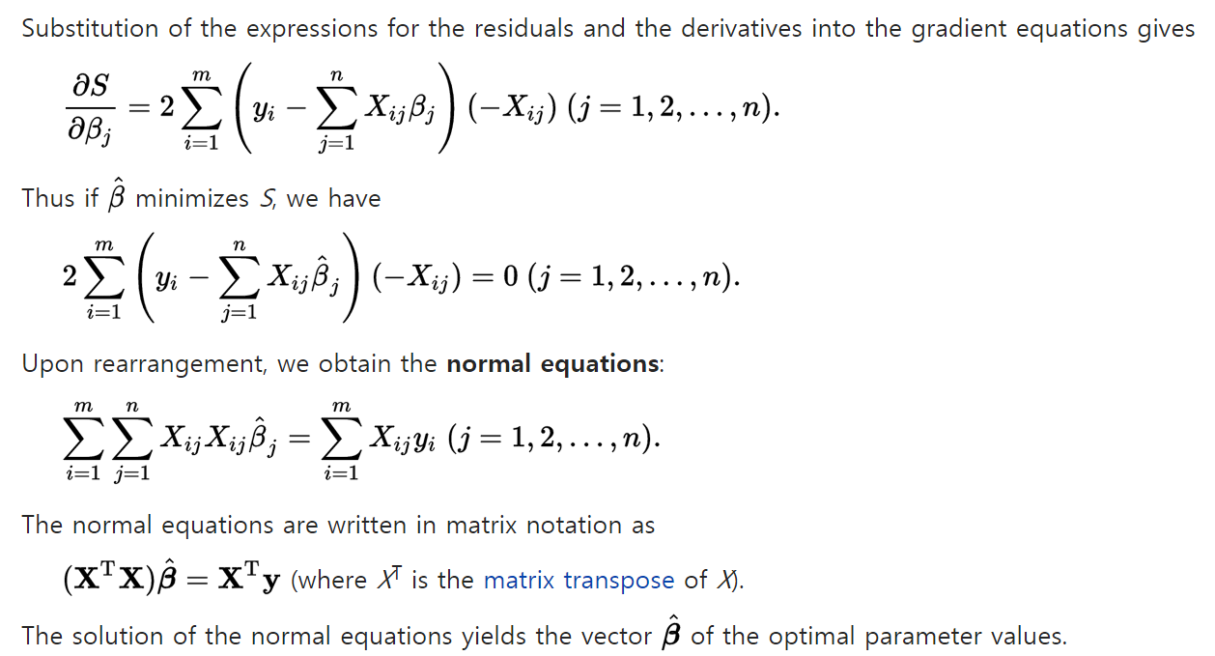
(참고)
최소제곱법의 계산 -분석적(analytic) 방법
https://en.wikipedia.org/wiki/Linear_least_squares_(mathematics)#Derivation_of_the_normal_equations

Slide 9
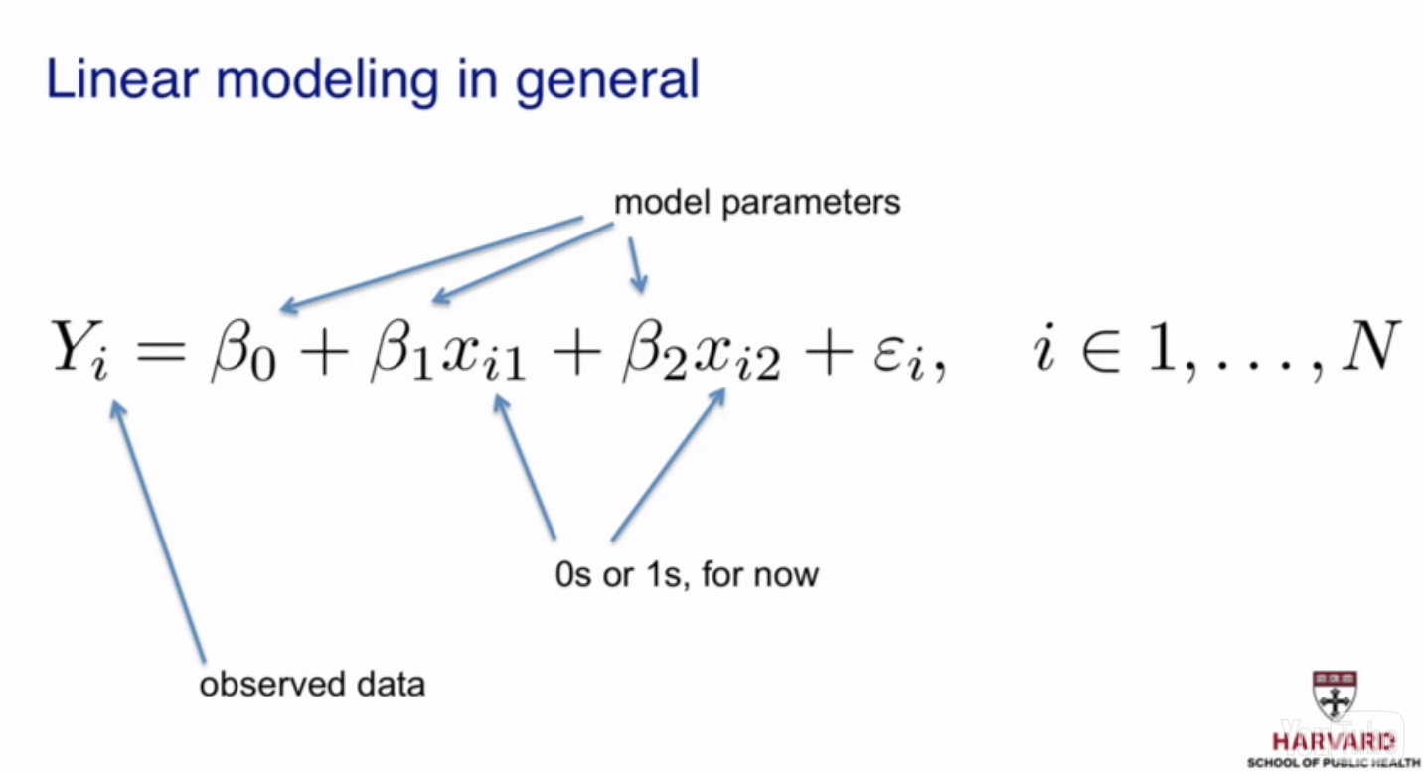
3. Linear Models as Matrix Multiplication

Slide 10
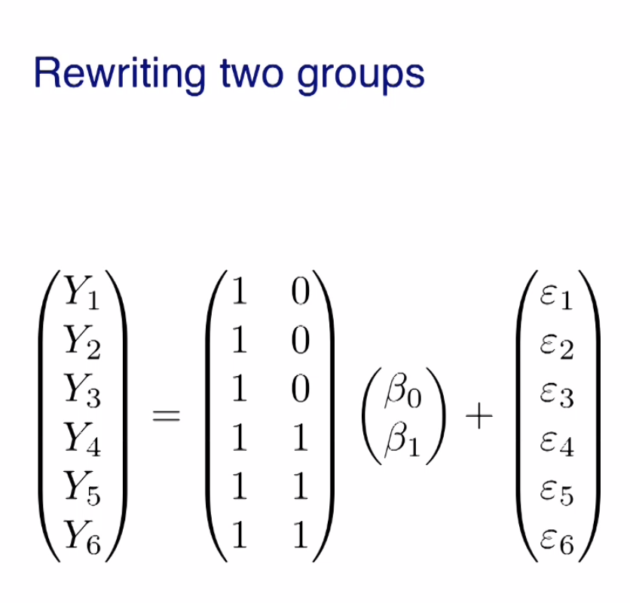

3. Linear Models as Matrix Multiplication
Non-matrix version
If you're in group A, you're going to get Beta0 plus an error.
If you're in group B, you're going to get Beta0 plus Beta1,
so you're up here, plus an error.

Slide 11
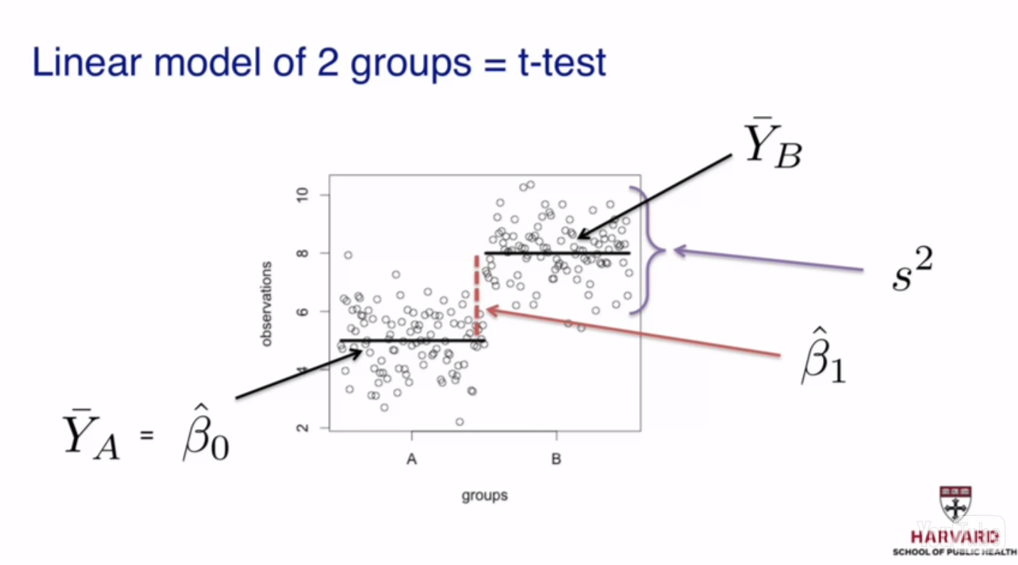
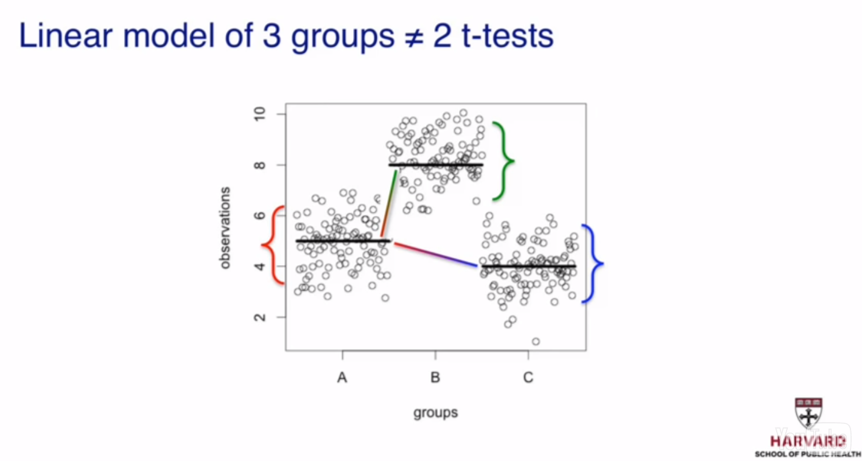
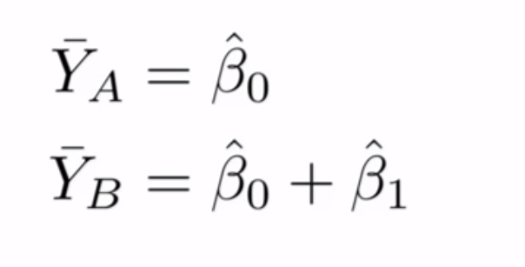
3. Linear Models as Matrix Multiplication
Non-matrix version
If you're in group A, you're going to get Beta0 plus an error.
If you're in group B, you're going to get Beta0 plus Beta1,
so you're up here, plus an error.

Slide 12
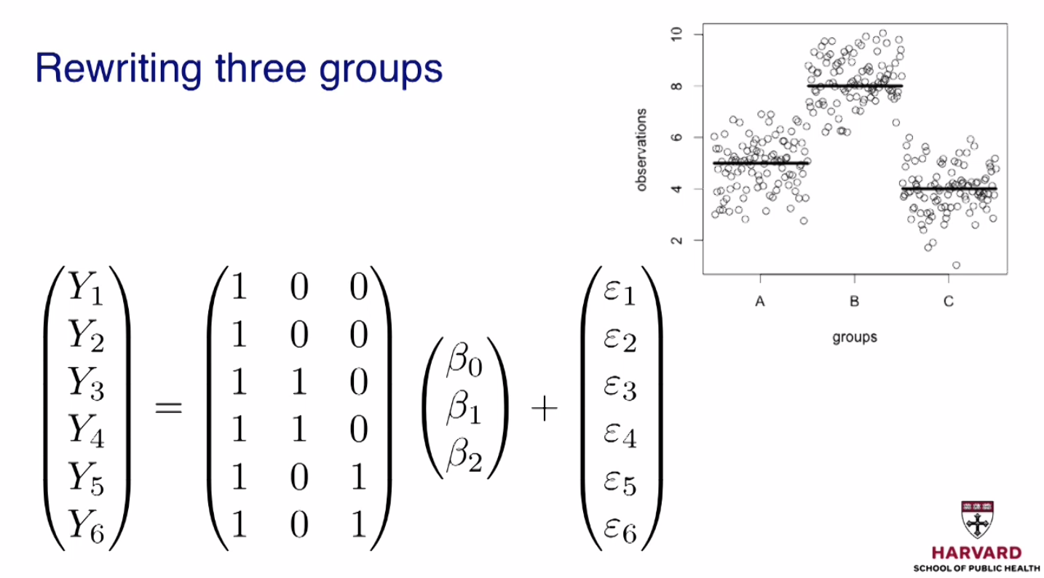
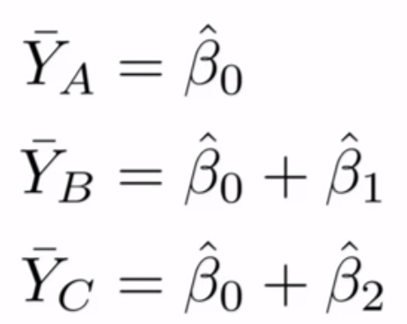
3. Linear Models as Matrix Multiplication
Now if you have three groups, again we can write it out in matrix notation.
So if you're in group 1, you multiply this by that.
You get Beta0 plus an error, and you're going to be one of these points here.
If you're in group 2, you're one of these guys.
Group B, so you get Beta0 plus Beta1, so you're up here, plus some error.
And the same goes for, if you're in group C.
It would be Beta0 plus Beta2 plus an error.
OK, so that gives us a pretty good idea of how
we can use matrix algebra to represent linear models
and make the mathematical derivations and computations faster and easier.
In the next modules, we're going to say a little bit more about these
are used in linear models and how they relate to testing.

Slide 13
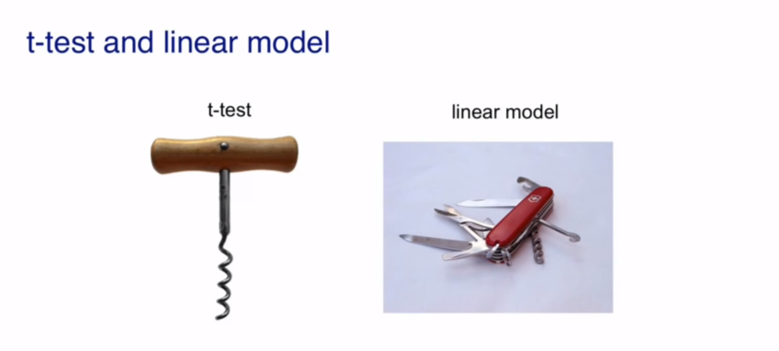
3. Linear Models as Matrix Multiplication
The t-test that we described in a previous module
is actually something can be derived from the linear model machinery.
You can think of the t-test as a corkscrew,
while linear models are much more applicable and much more general,
so you can think of it as a Swiss Army knife.

Slide 14
실습

Slide 15

실습1. Expressing design formula in R
The Design Matrix
group <- factor(c("control","control","highfat","highfat"))
model.matrix(~ group)
More variables
diet <- factor(c(1,1,1,1,2,2,2,2))
sex <- factor(c("f","f","m","m","f","f","m","m"))
model.matrix(~ diet + sex)
The interaction model
model.matrix(~ diet + sex + diet:sex)
or model.matrix(~ diet*sex)
## (Intercept) grouphighfat
## 1 1 0
## 2 1 0
## 3 1 1
## 4 1 1

Slide 16
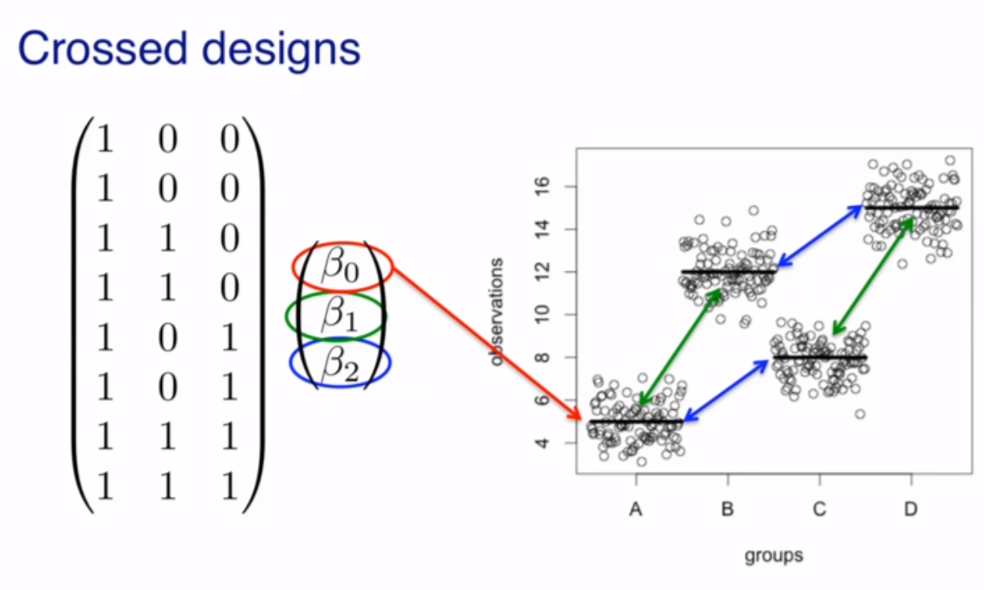
실습1. Expressing design formula in R

Slide 17
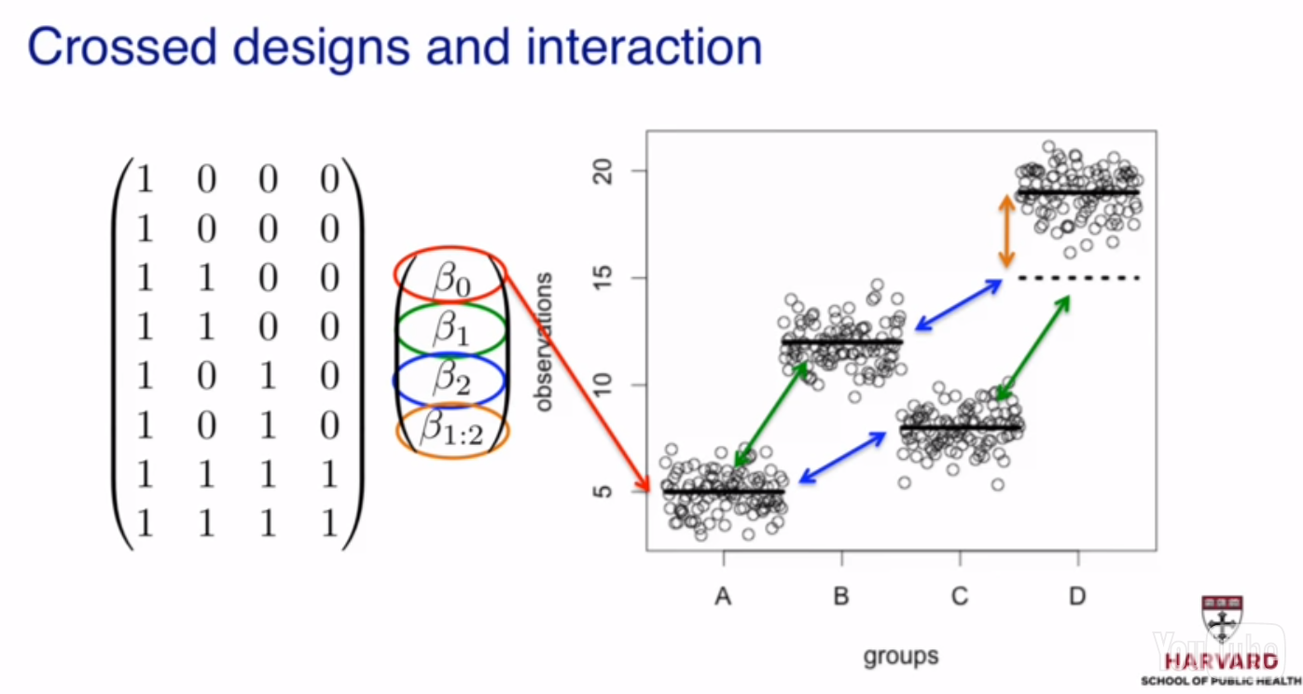
실습1. Expressing design formula in R

Slide 18
실습2. Linear models in practice
The mouse diet example
X <- model.matrix(~ Diet, data=dat)
fit <- lm(Bodyweight ~ Diet, data=dat)
the t-statistic is the same:
ttest <- t.test(s[["hf"]], s[["chow"]], var.equal=TRUE)

Slide 19
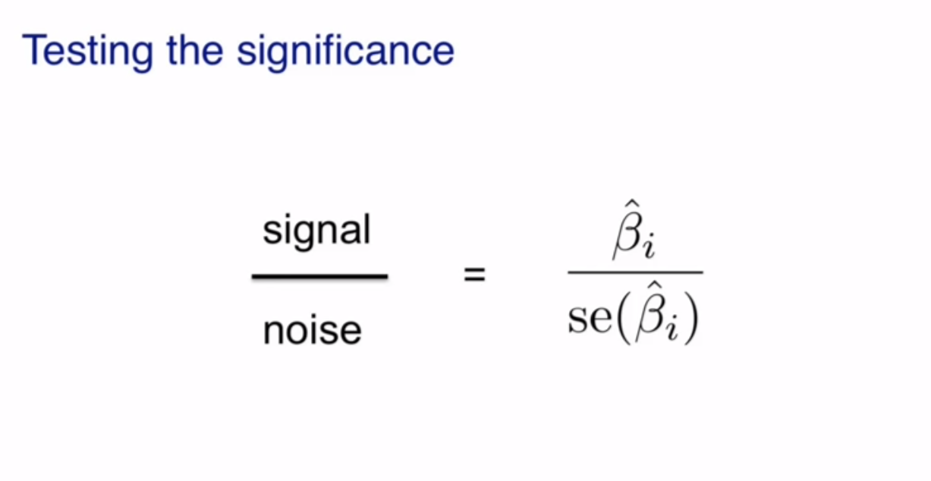
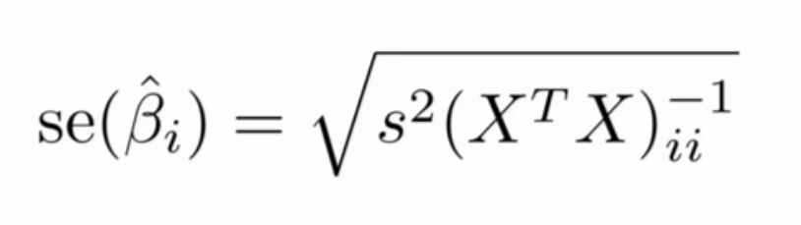
실습3. Standard errors

Slide 20



실습3. Standard errors
estimate standard errors of linear model estimates
Falling object example
The constant is fixed, but our estimates are not. (a random variable)
To see this we can run a Monte Carlo simulation.
Father and son heights example
Variance-covariance matrix
estimate standard errors of linear model estimates(beta hat)
LSE standard errors

Slide 21



실습4. Interactions and contrasts
Contrasting coefficients
a comparison which is not a single coefficient, but a combination of coefficients
L3vsL2 <- contrast(fitTL, list(leg="L3",type="pull"), list(leg="L2",type="pull"))
A contrast is a combination of estimated coefficient: ,where c is a column vector with as many rows as the number of coefficients in the linear model.
The standard error of the contrast estimate :
Linear Model with Interactions
X <- model.matrix(~ type + leg + type:leg, data=spider)
fitX <- lm(friction ~ type + leg + type:leg, data=spider)
Analysis of variance
anova(fitX)

Slide 22
실습5. Co-linearity(공선)
Notes:
-System of equations example
I've written a system of equations here with three variables
and three equations, which, in general, has a unique solution.
But this particular one doesn't.
-Model matrix for linear model with two factors
The first column is an intercept.
The second column was the push versus pull for the type.
The third column was the L2 versus L1.
Fourth column was L3 versus L1.
And the fifth column was L4 versus L1.
So the interaction model adds these three extra columns, the 6, 7, and 8.
These three columns are the product of the second column,
the push versus pull effect, and the following three columns.
So the sixth column here is the product of push versus pull and L2 versus L1.
So the black indicates the ones.
So the indicator here has ones for the samples,
which are push and which are L2.
And we do the same for L3 and for L4.

Slide 23


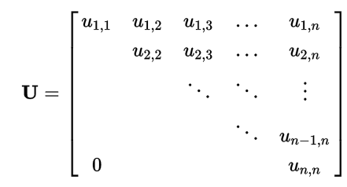

실습6. The QR decomposition
QR 분해(QR decomposition, QR factorization)는 임의의 행렬을 직교행렬과 상삼각행렬의 곱으로 분해하는 방법이다.
QR 분해는 선형 최소제곱법을 풀 때나 고유벡터를 구할 때 등의 상황에 사용되며, 그람-슈미트 직교정규화 혹은 하우스홀더의 방법 등을 사용한다.
직교행렬(orthogonal matrix):
상삼각행렬(upper triangular matrix): 대각항의 아래쪽 항들의 값이 모두 0인 정삼각행렬
https://ko.wikipedia.org/wiki/QR_분해

Slide 24
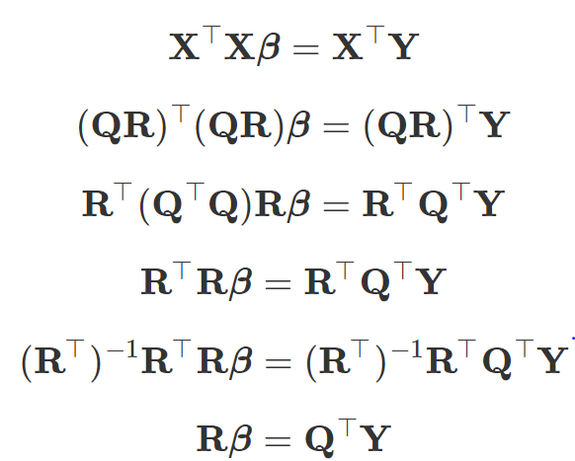
실습6. The QR decomposition
Finding LSE with QR
QR <- qr(X)
betahat <- solve.qr(QR, y)
This gives us identical results
to the lm function.

